Slide 1


Implementation of an autonomous driving system in simulation software
Applicative project - Computer Science – Big Data

Slide 2

Contents
Introduction
Specifications
Project Management
Technical overview
Conclusion

Slide 3

Introduction
Passionate about AI
Personal formations
Sigma Group & AI Racing

Slide 4
Specifications
Technical Specifications
The car has to :
Have 4 contacts points with the track
Be 30x25x25 cm
Weight 4kg max
Have a max total battery power 7800 mAh
Have 2 motors maximum
Have a circuit-cutter for emergency purpose
Be autonomously controllable

Slide 5
Specifications
Start & Finish
Start :
Luminous countdown ( red, yellow, green with 10x10 cm traffic light)
2min max to start & false start will be penalysed
Finish :
Car stop itself within 5s after crossing the finish line (15cm height yellow band accross the whole track width)

Slide 6
Specifications
The track

Slide 7
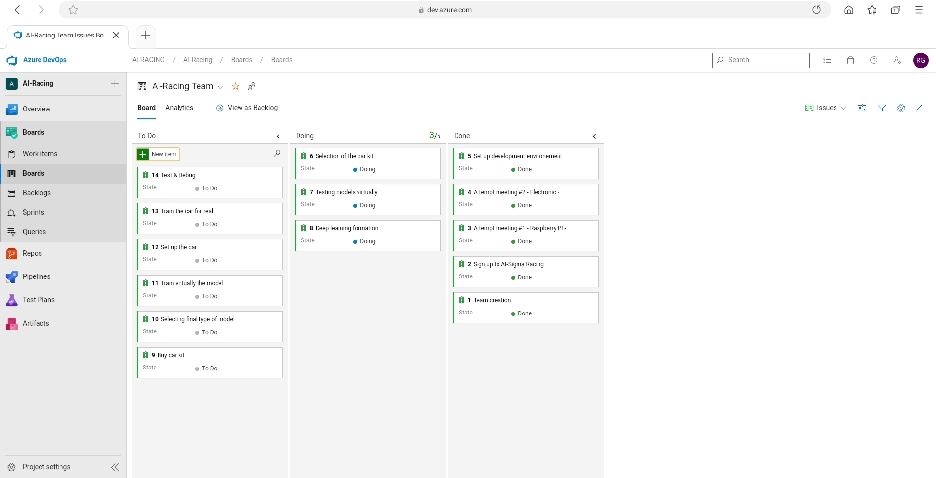
Project management
Azure DevOps

Slide 8
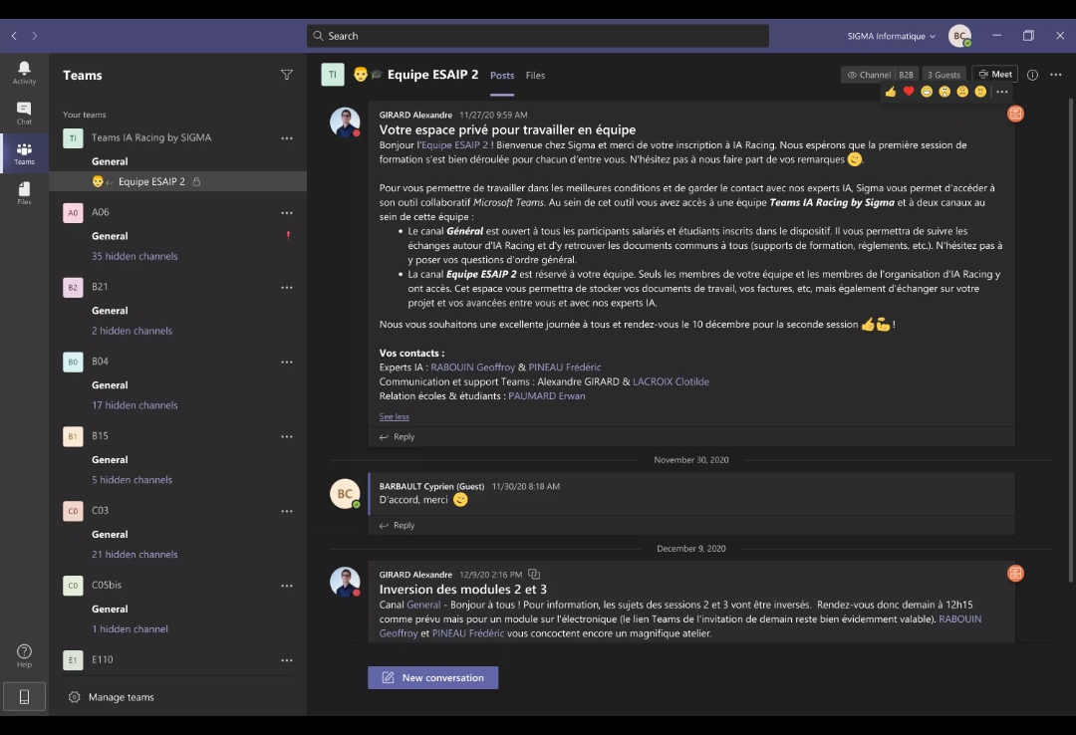
Project management
Teams meeting with Sigma

Slide 9
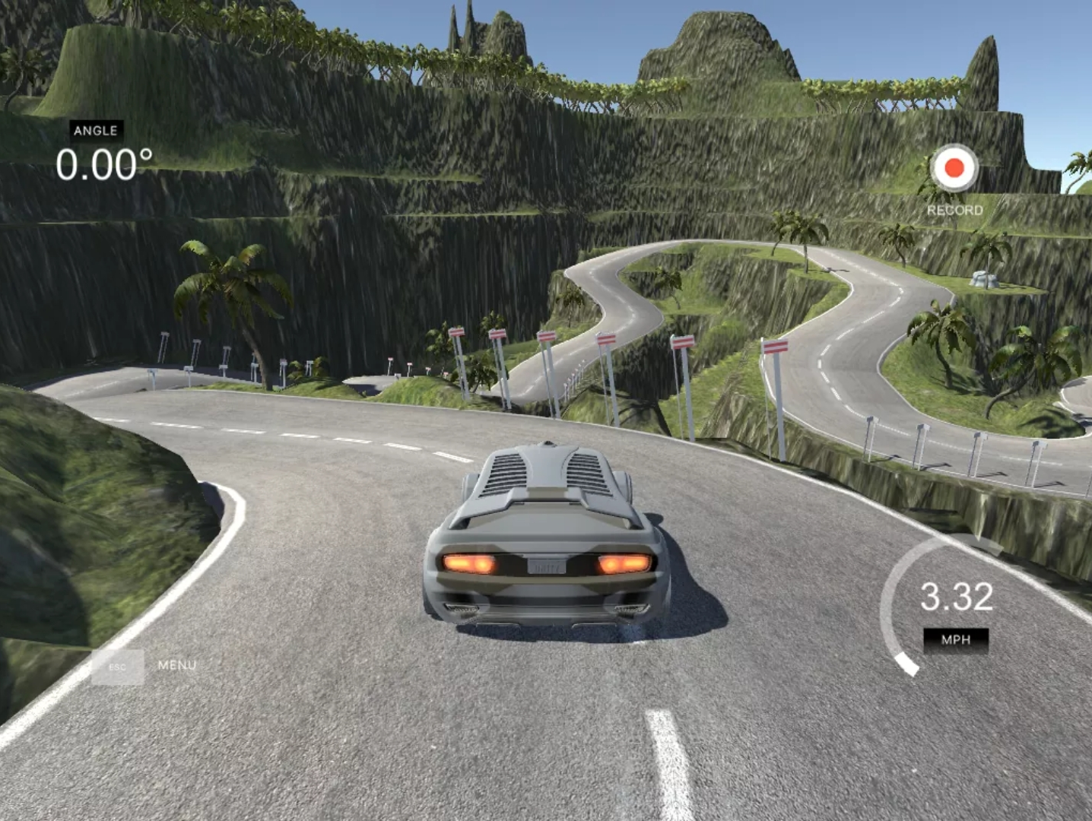
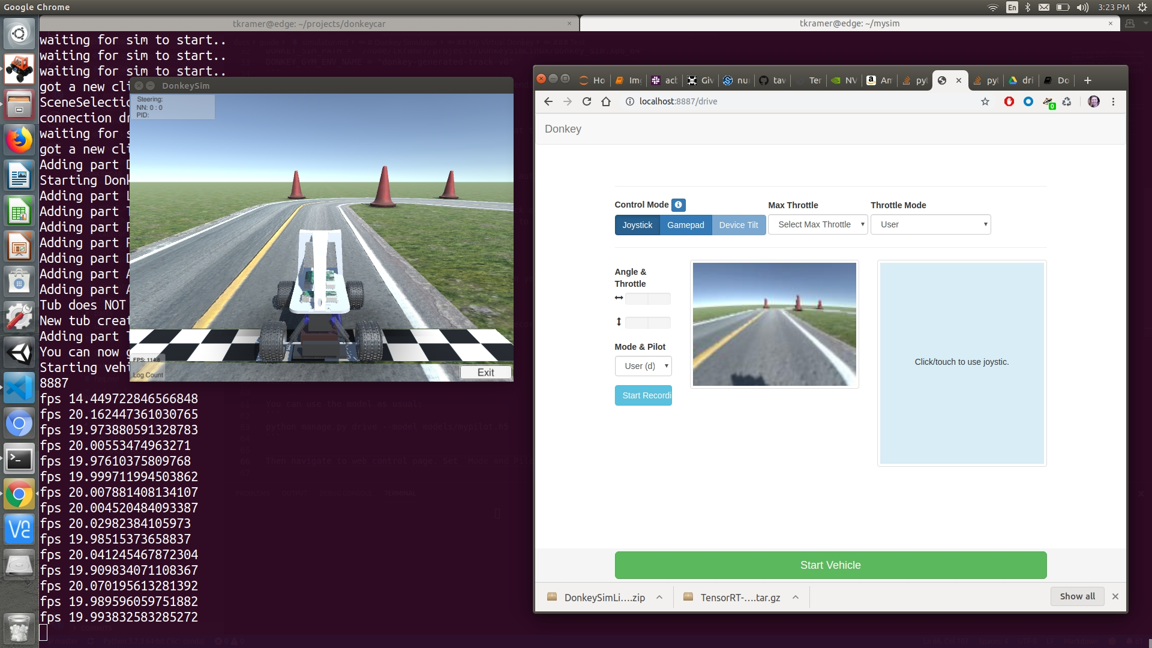
Technical overview
Donkey vs Udacity Simulators
Udacity simulator
DonkeySimulator

Slide 10
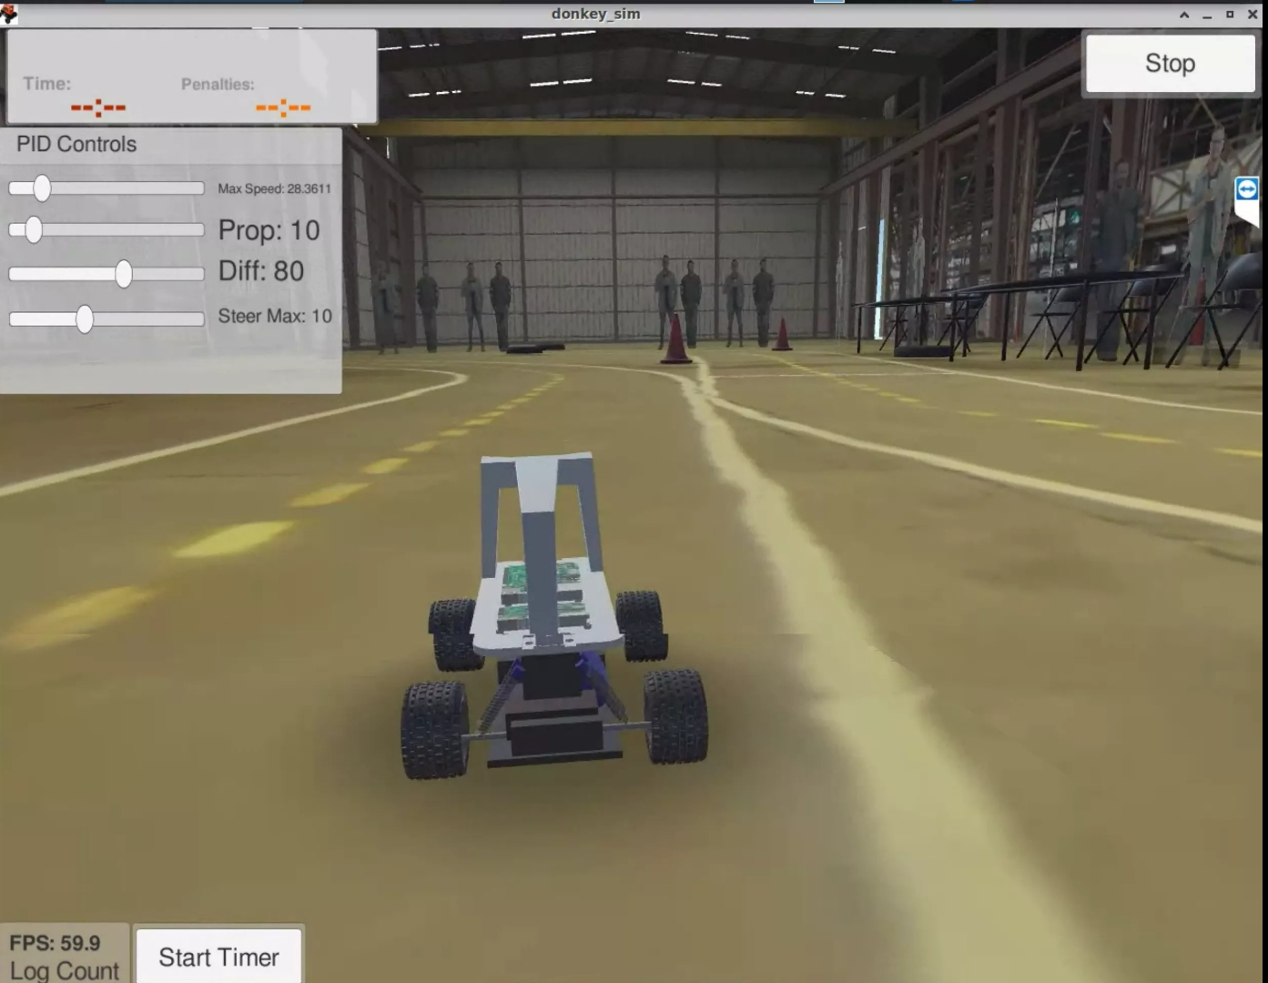
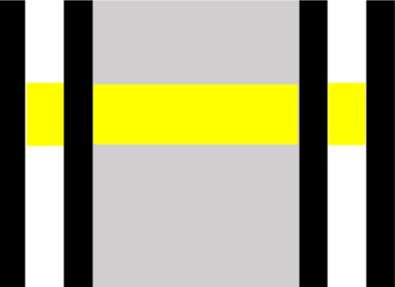
Technical overview
Donkey vs Udacity Simulators
Our track
DonkeySimulator

Slide 11
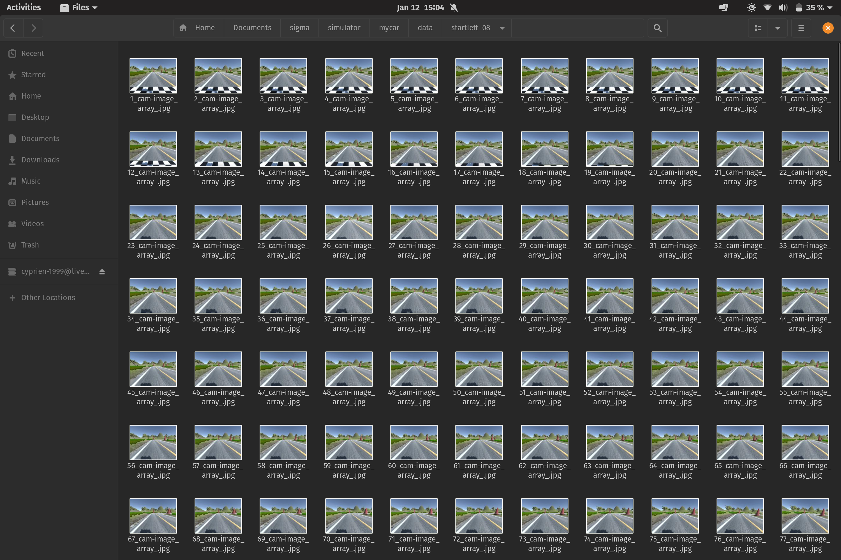
Technical overview
Dataset

Slide 12
Technical overview
Our model
Video

Slide 13
Conclusion
Next steps :
Build the car
Build our own custom track for training & testing
Implement PID Controller
Tune our model
Implement visual odometry

Slide 14

Conclusion
Thanks for listening !!

